Slide 1
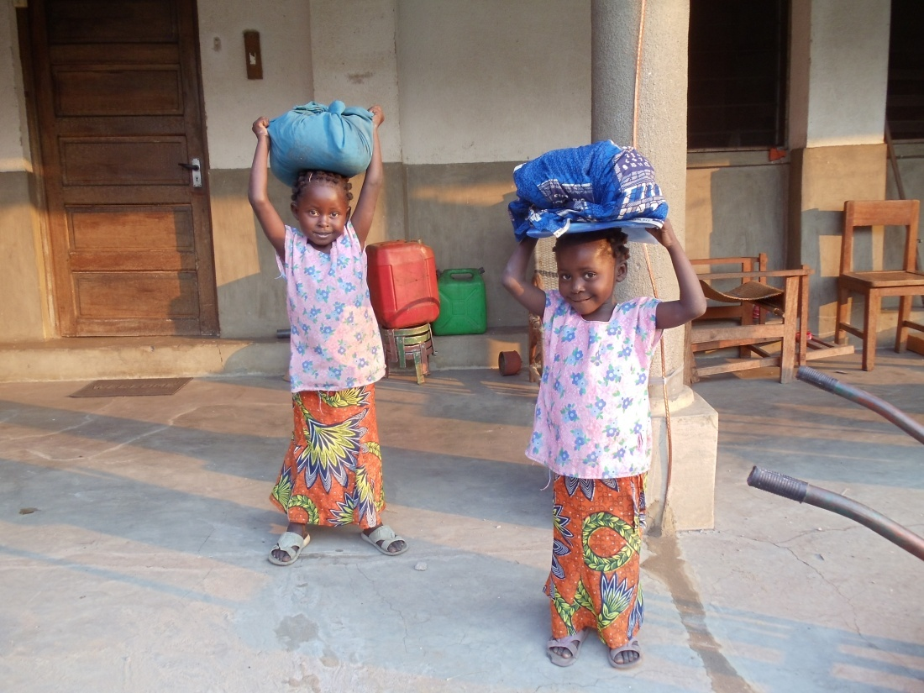
« Teach them what they need to know for life. »
St. Julie Billiart

Slide 2
We Sisters of Notre Dame are called: to address, as far as possible, issues of translation and equal access to technology and information
Chapter Acts 2002

Slide 3
Photovoltaic Project
What is it?

Slide 4
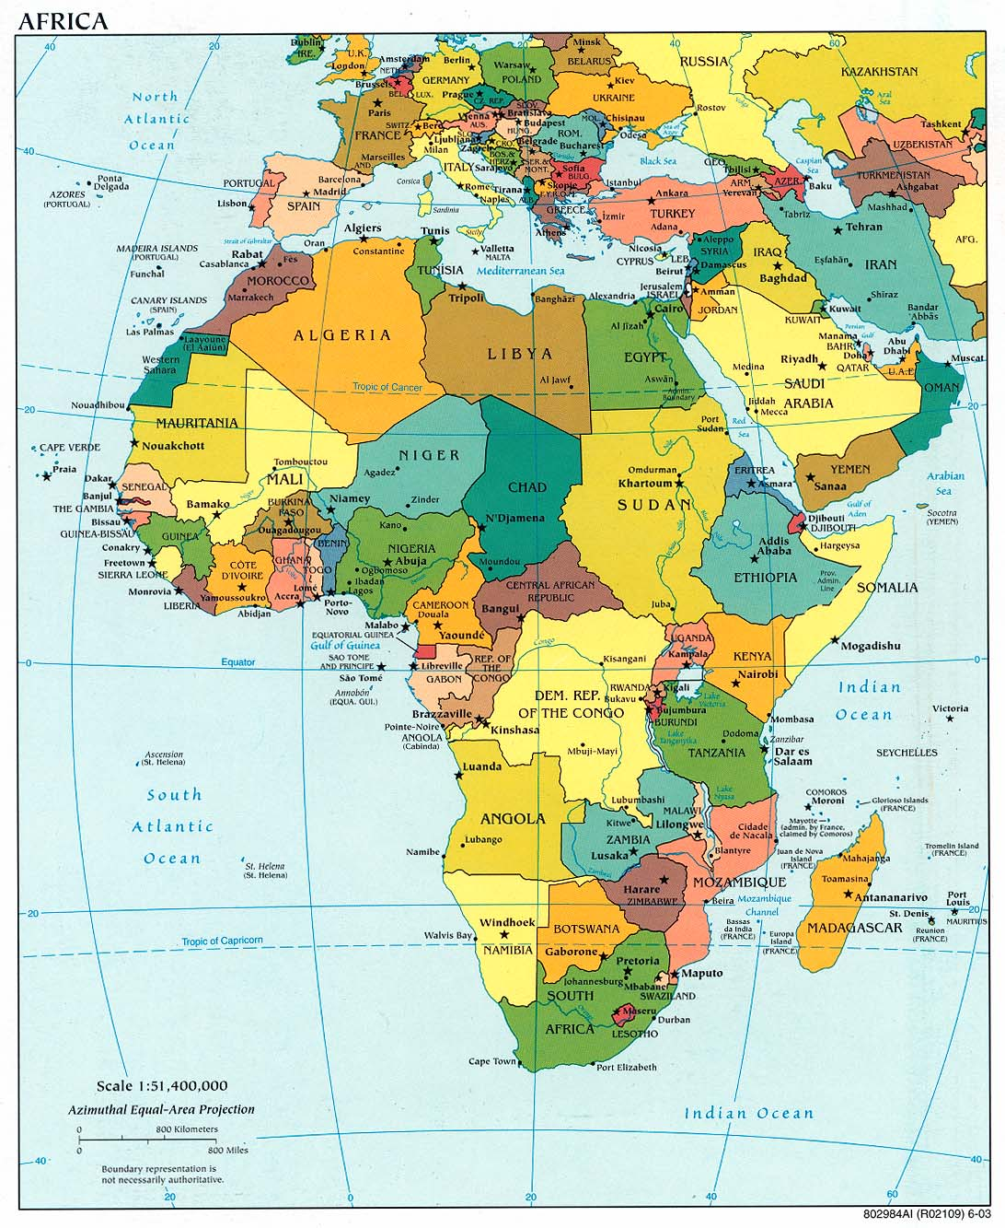
An enviromental project of the Sisters of Notre Dame de Namur providing electricity, clean water and internet access, using the power of the sun, for their missions in Nigeria and the Democratic Republic of Congo.

Slide 5
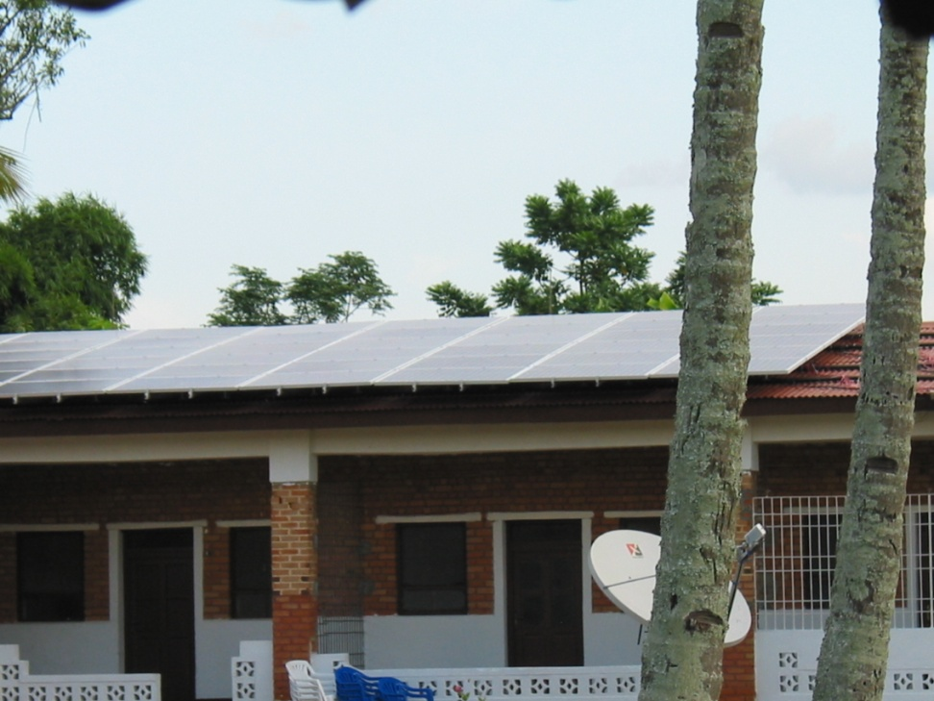
The project provides three services.
The solar panels for electricity.

Slide 6
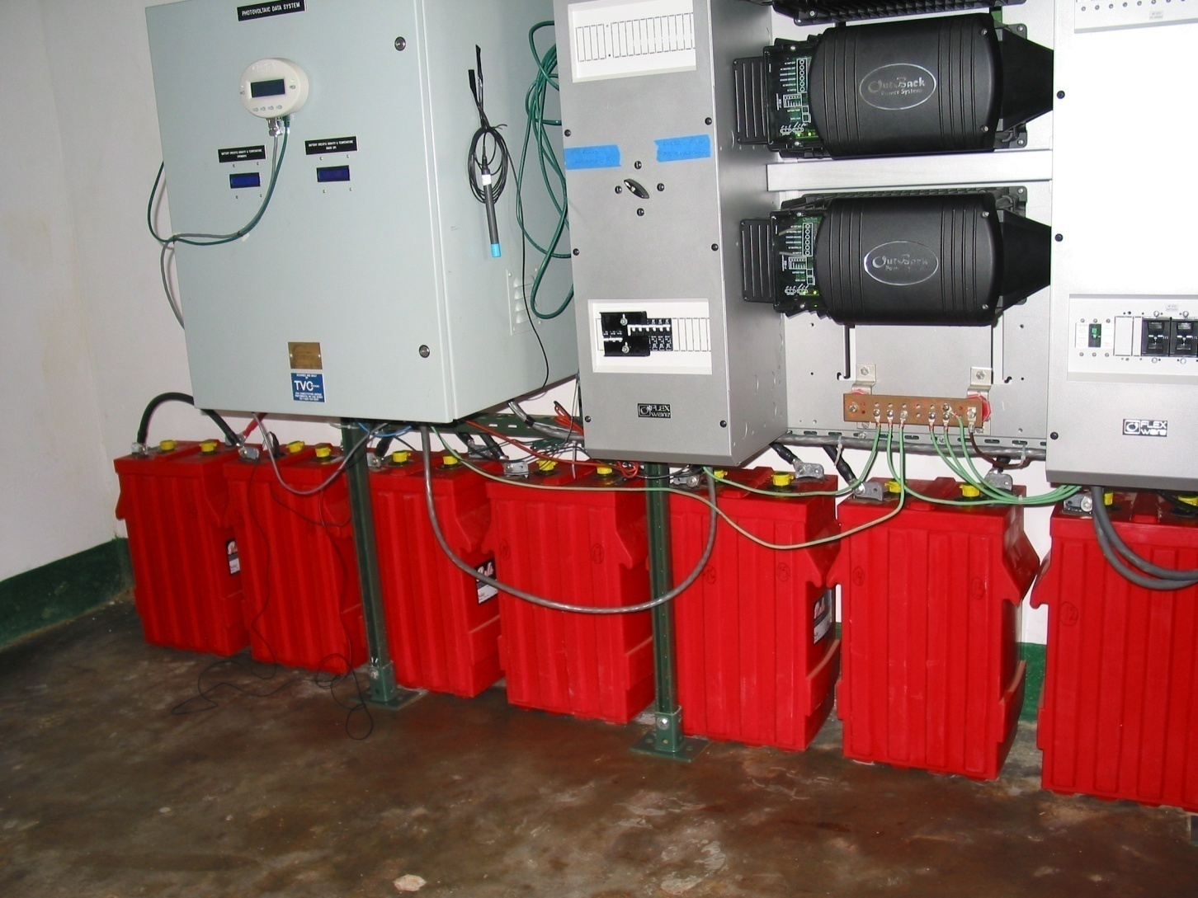
The batteries store the electricity for up to seven days.

Slide 7
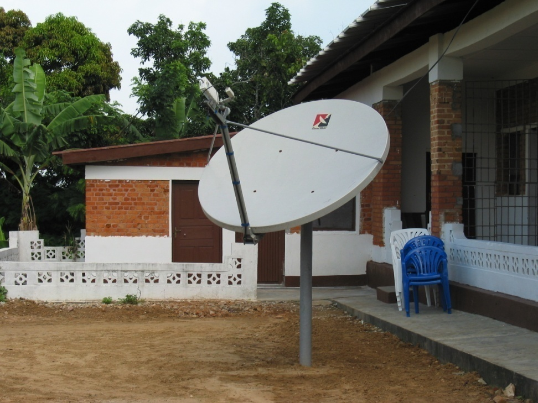
The satellite for communication and internet access

Slide 8
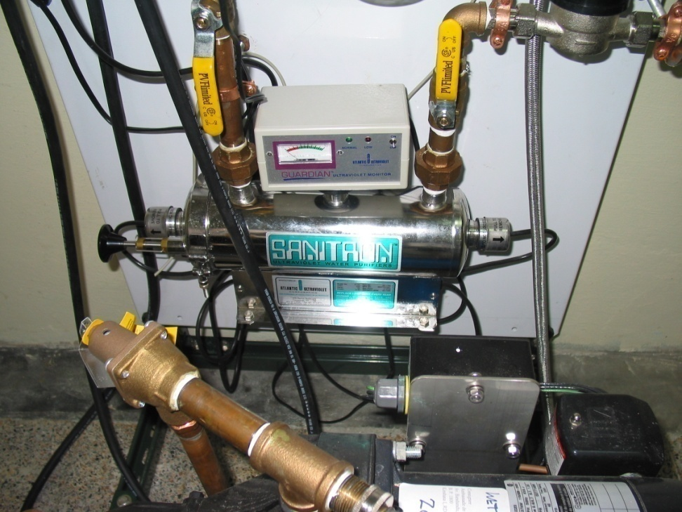
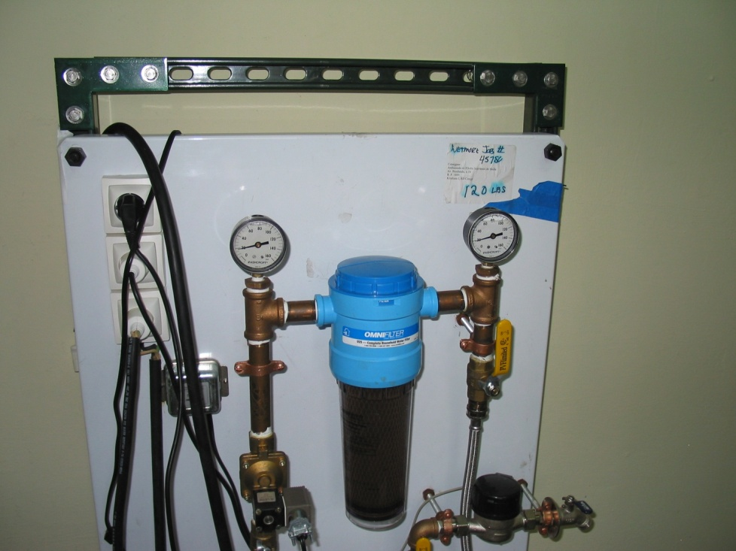
The water purification system

Slide 9
Why?
In order to provide possibilities:

Slide 10
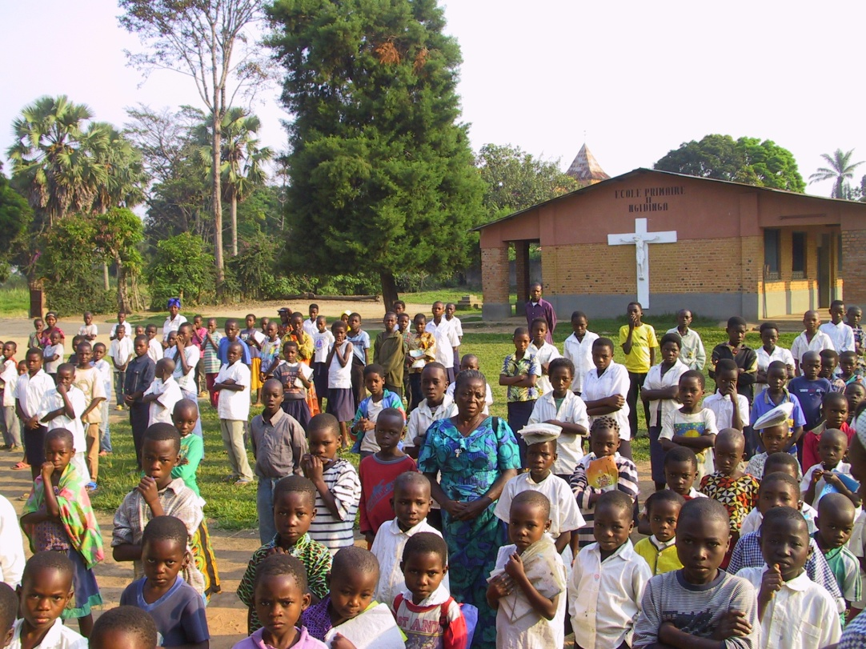
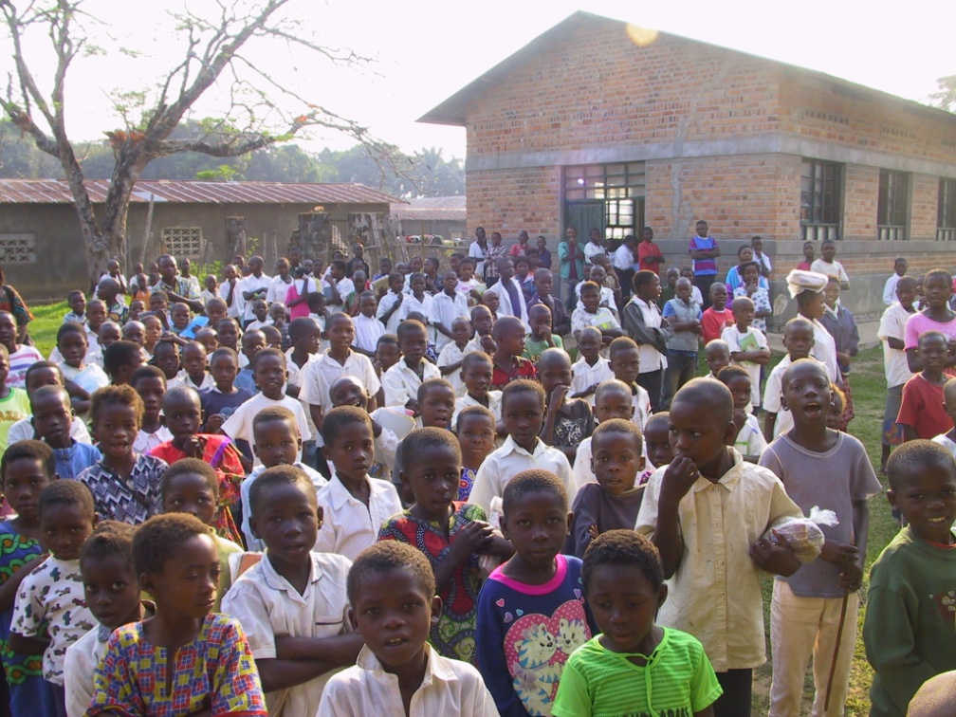
For new learning in the Notre Dame Primary and secondary schools of Nigeria & Congo

Slide 11
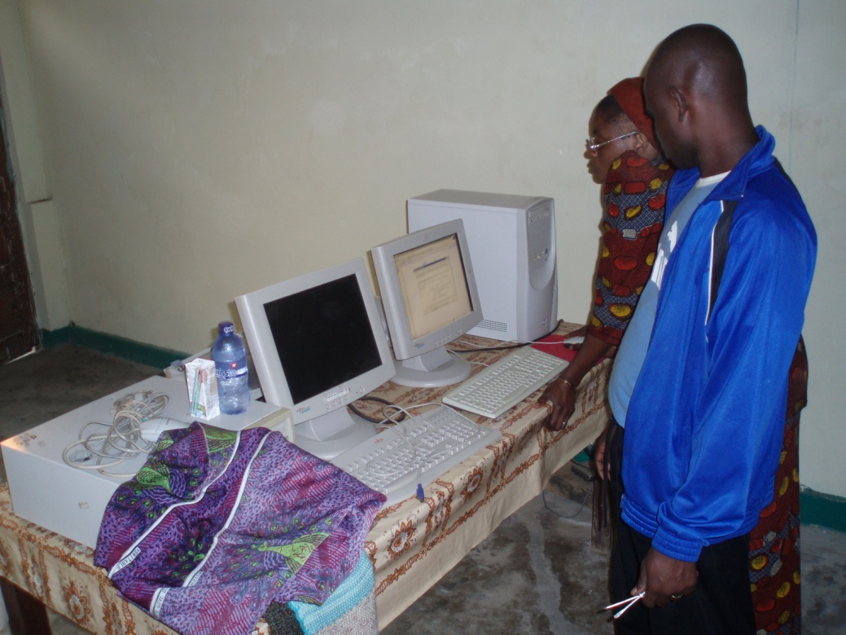
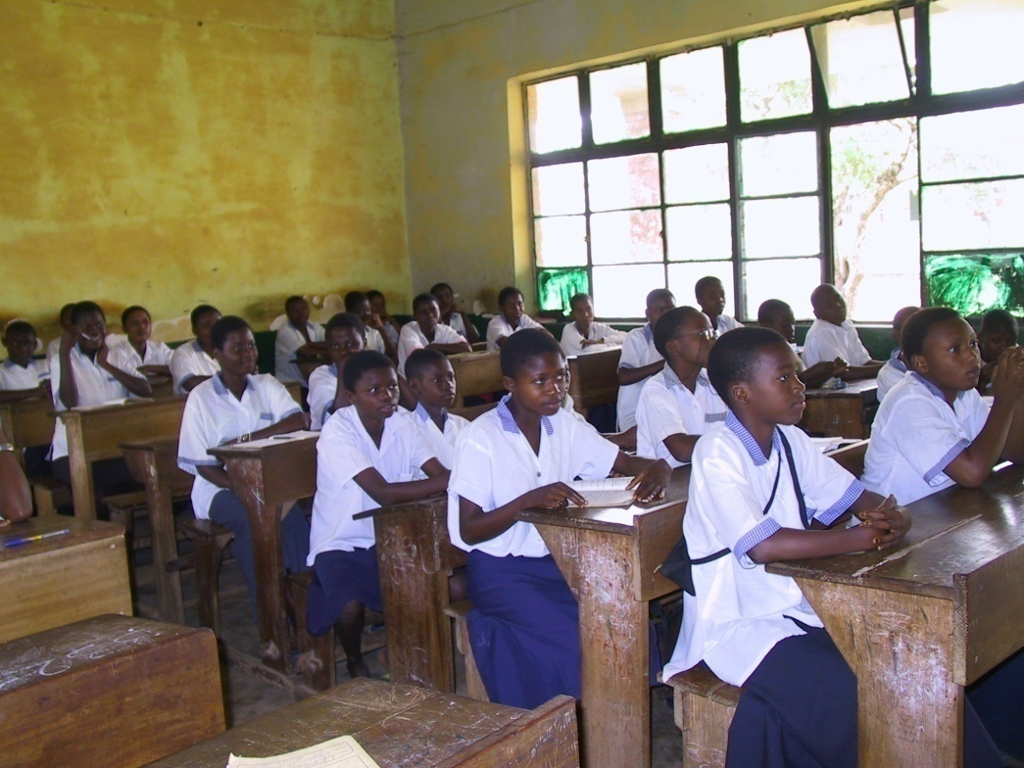
Allowing rural secondary school students a chance to learn skills that may open a new world for them.

Slide 12
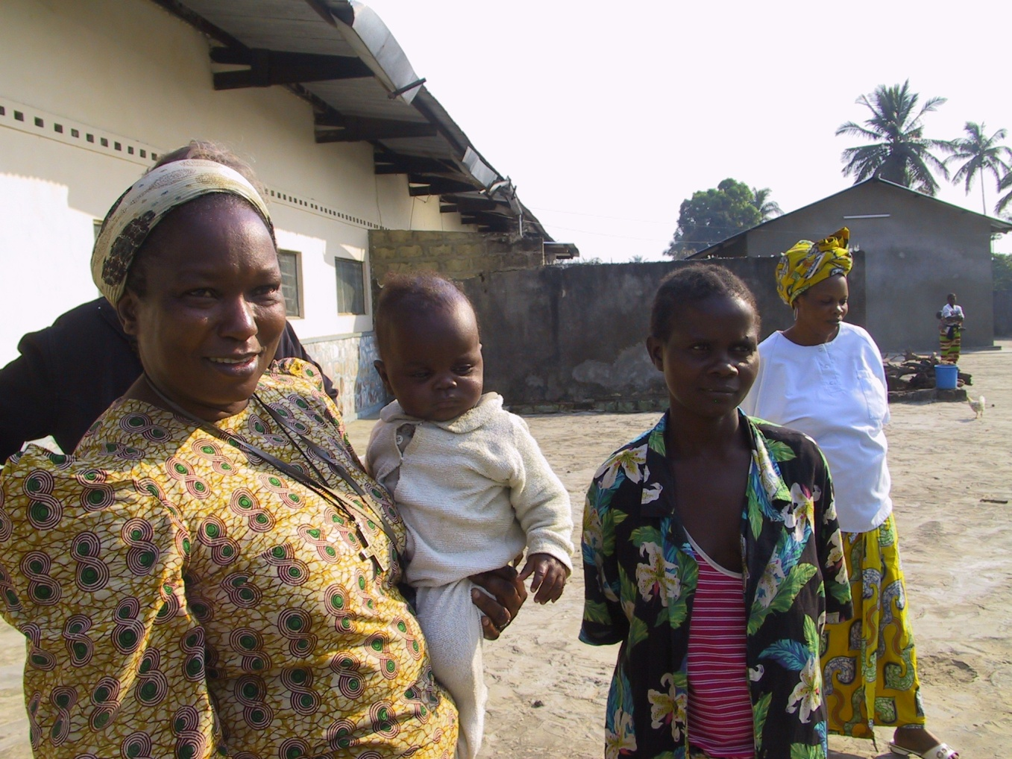
For better health care through the clinics run by the Sisters that provide the only medical attention available to a large population.

Slide 13
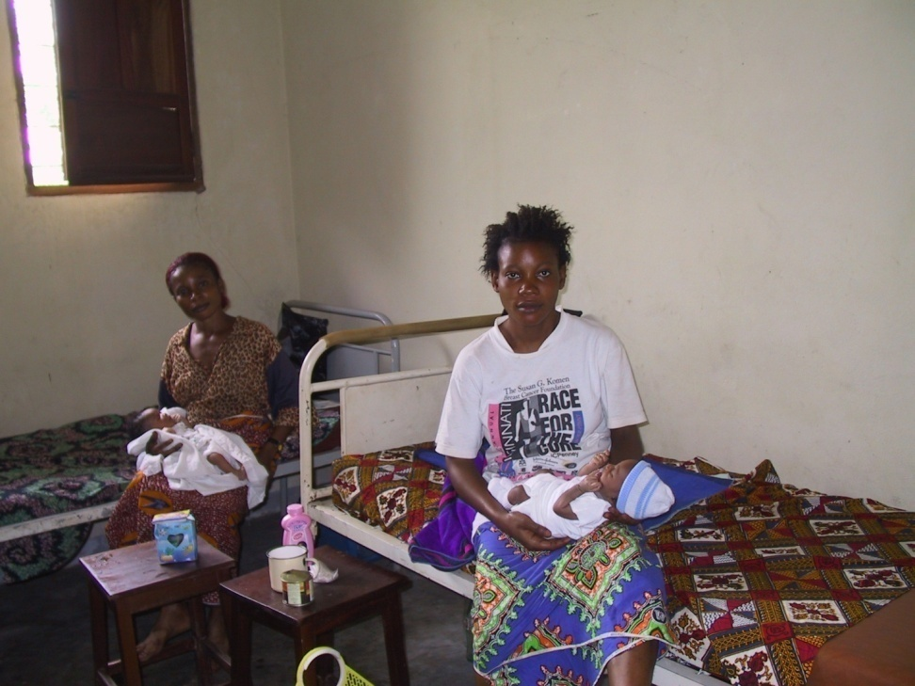
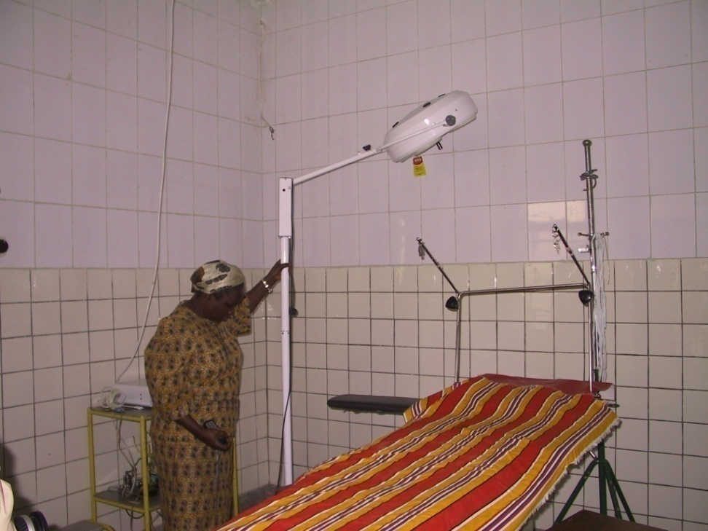
For dependable electricity to a hospital with 135 beds and a large maternity unit.

Slide 14
Where does this exist?
Systems were installed in:
- Cuvilly Arts and Earth Center ,Ipswich, October, 2005
-Fugar, Nigeria, October, 2006
- Ngidinga, Congo, February, 2008
- Awkunanaw, Nigeria, October, 2008
Kitenda, Congo, July 2010
Lemfu, Congo, July, 2010
Pelende, Congo, July 2010

Slide 15
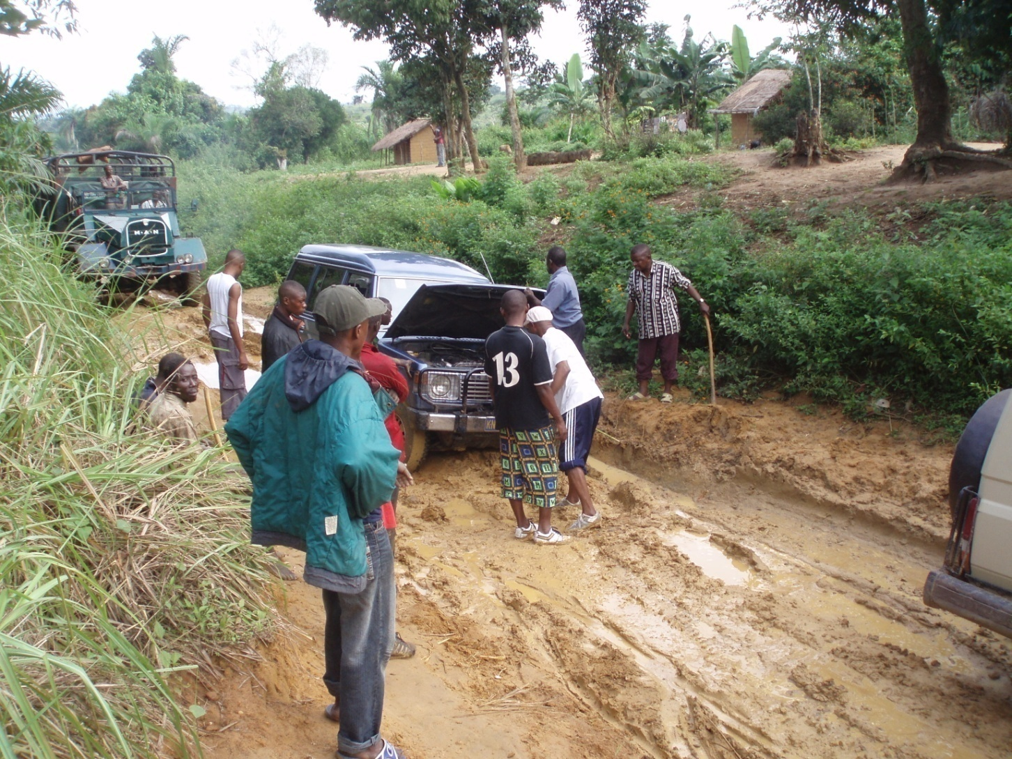
Construction of the sites offer many challenges. Just getting to the site may take a bit longer than expected!

Slide 16
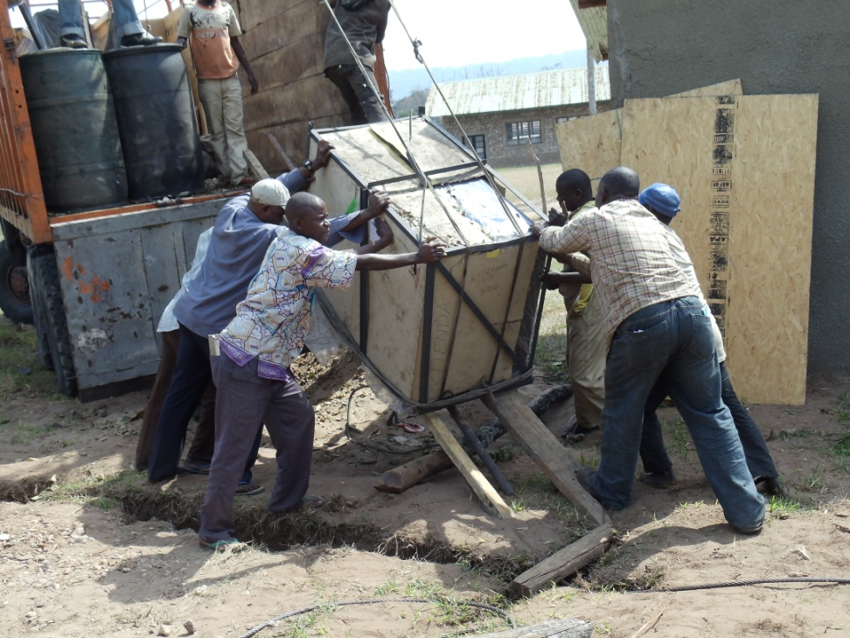
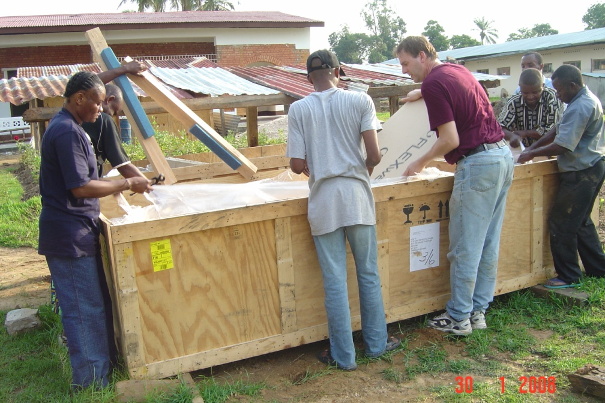
Materials are shipped in wooden crates and carefully unloaded and unpacked on site.

Slide 17
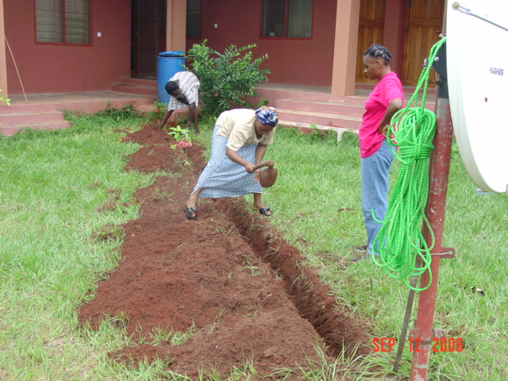
Trenches are dug for the cables.

Slide 18
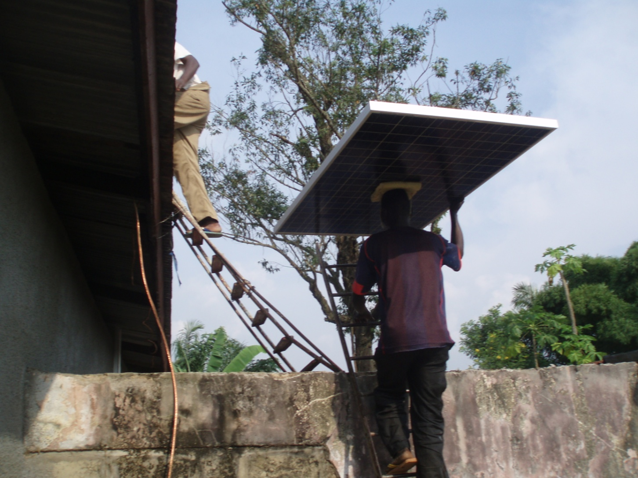
The panels are carried to the roof for installation.

Slide 19
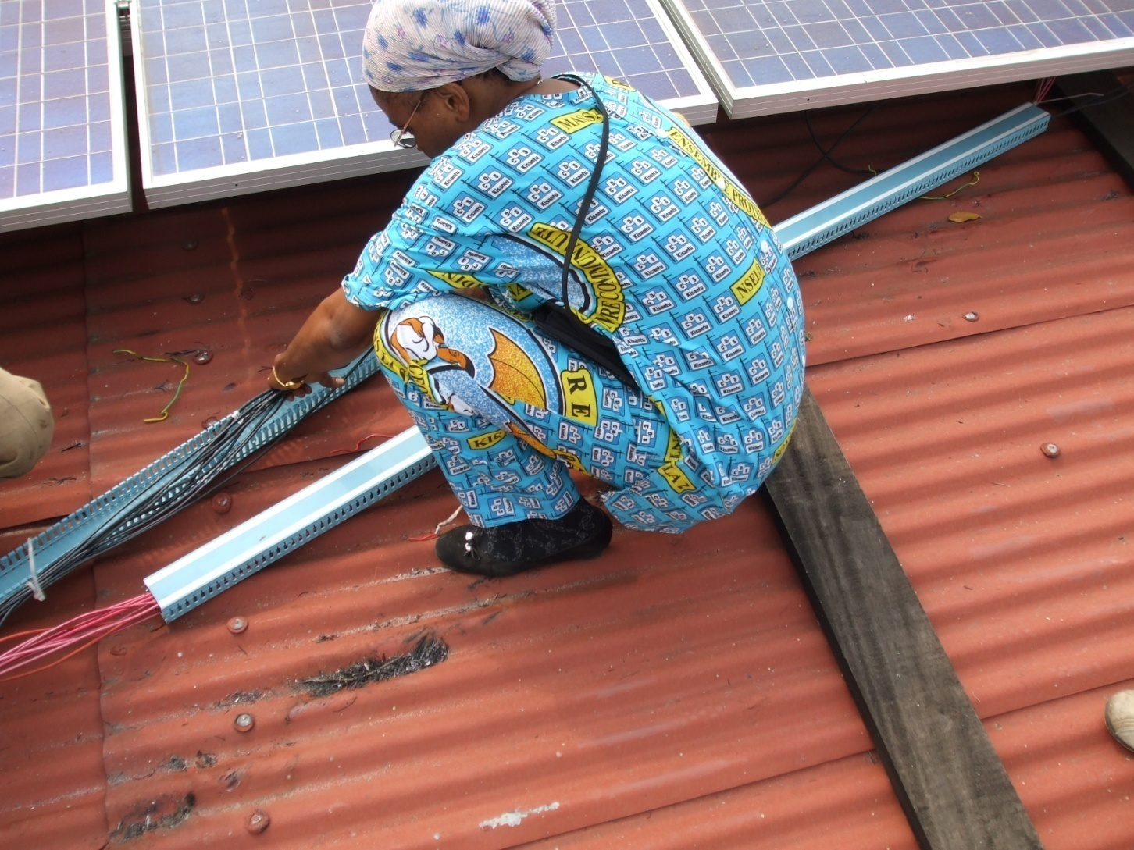
The sisters are committed to learning everything about the Photovoltaic System.

Slide 20
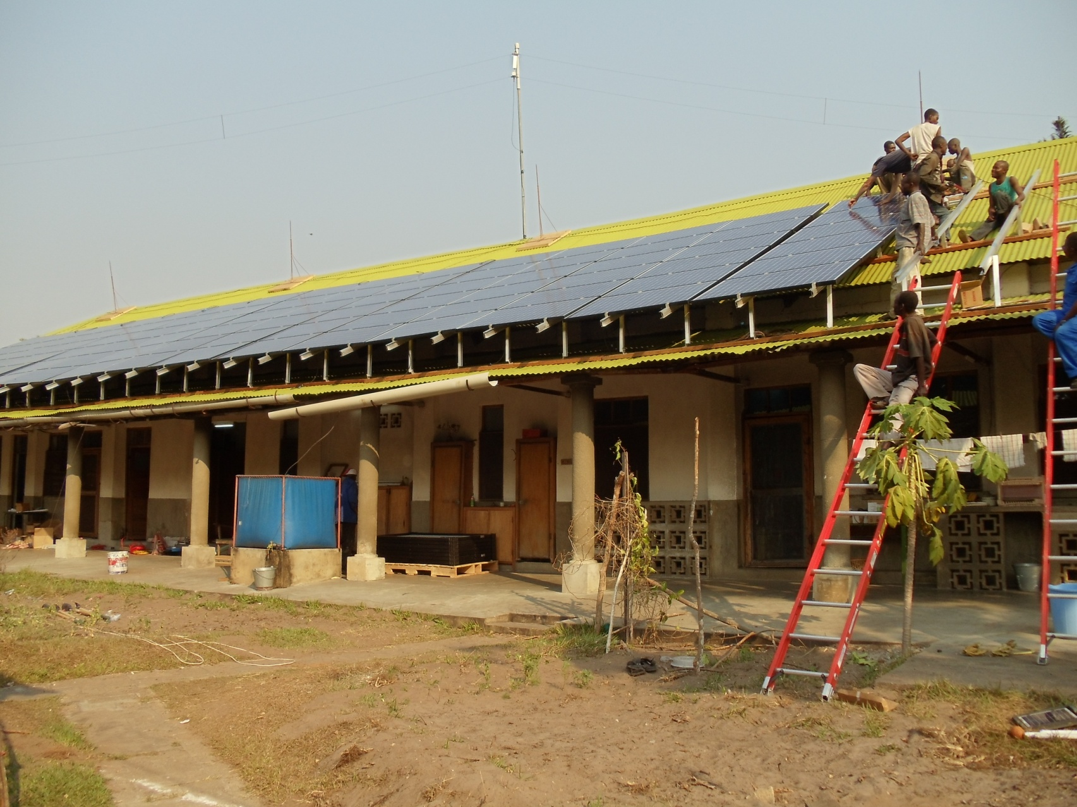
The panels are set in place on the roof.

Slide 21
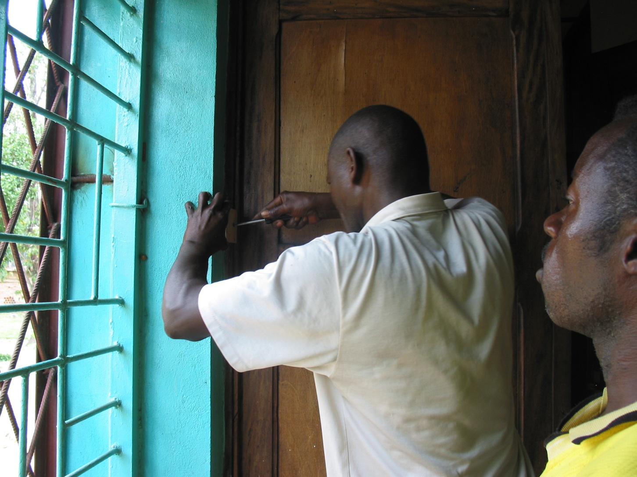
Co-workers are also involved and are learning all about the project.

Slide 22
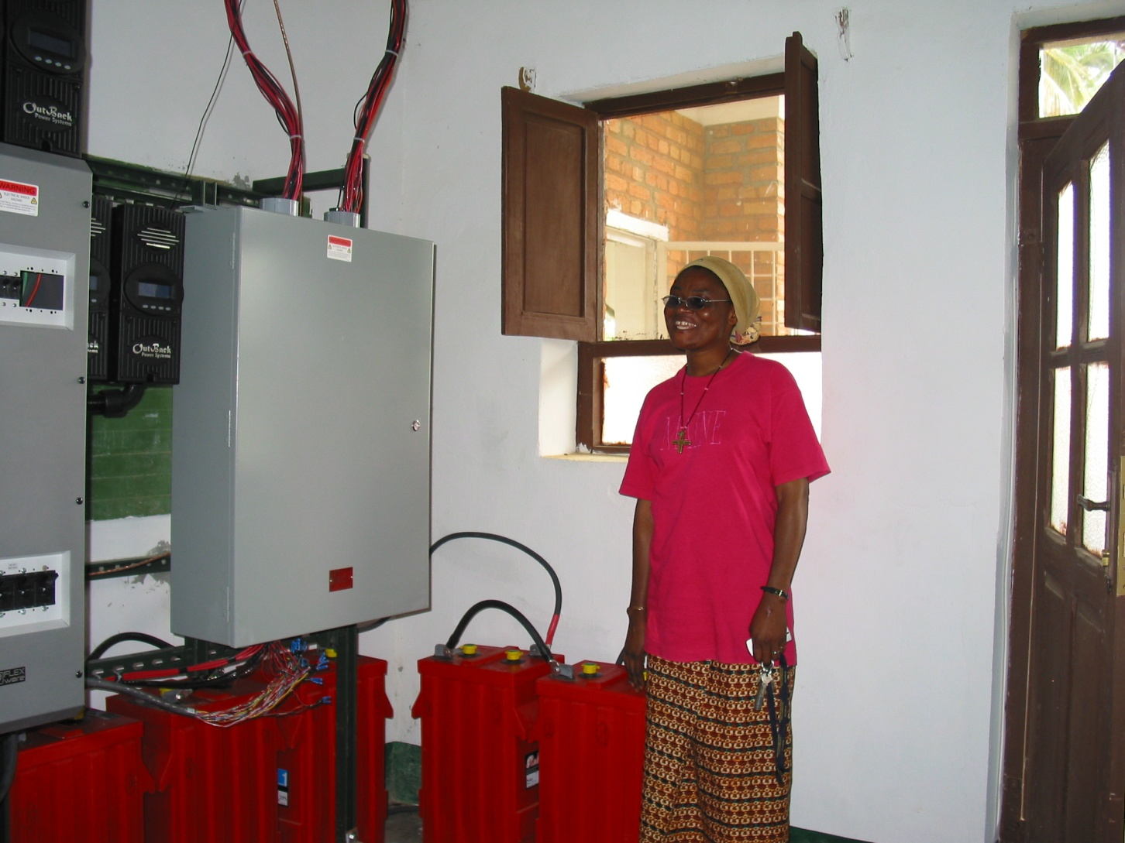
Sister Dorothée is happy that the project is completed and all is working!

Slide 23
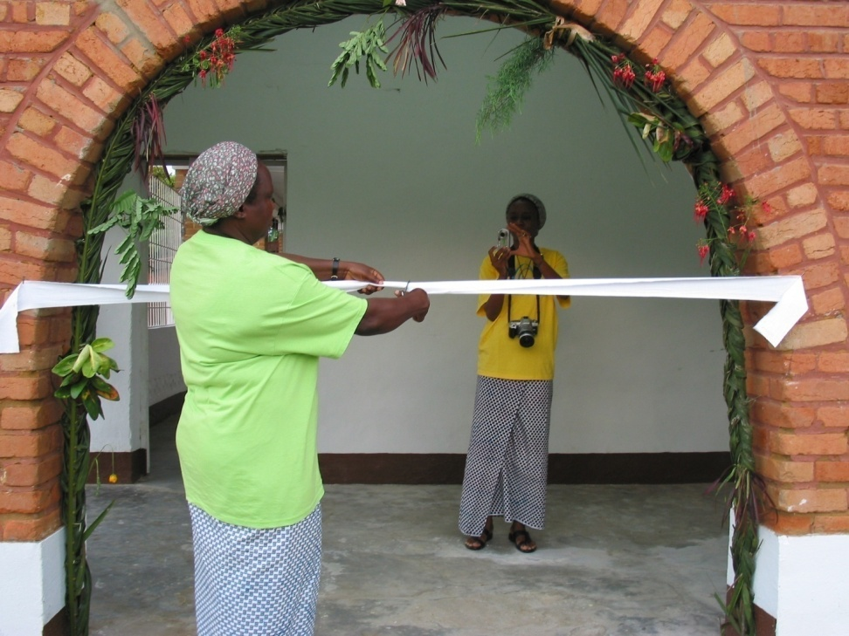
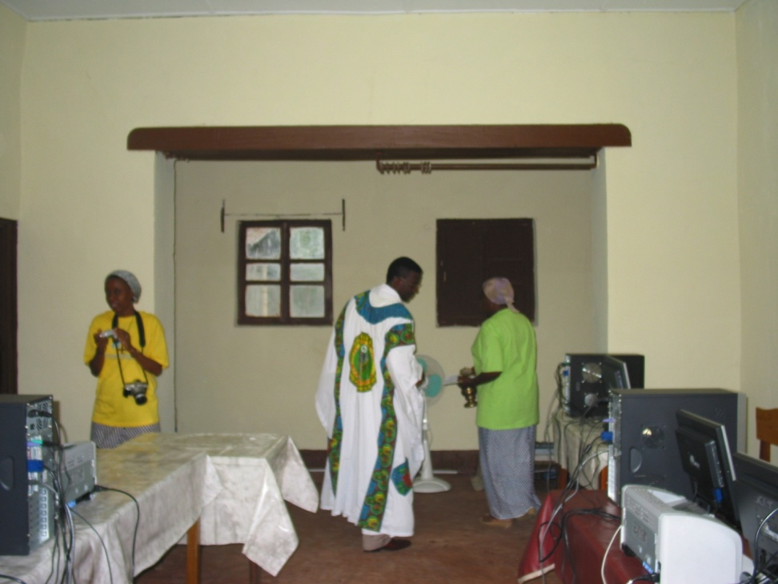
The project would not be complete without a ribbon cutting and a blessing to inaugurate the Project

Slide 24
What has happened since?

Slide 25
Many lives have been affected because of the systems installed in July 2010
Lemfu: Primary students: 200
Secondary students: 320
Hospital beds: 75
Pelende: Primary students: 500
Secondary students: 300
Hospital beds: 80
Kitenda: Primary students: 400
Secondary students: 220
Hospital beds: 65

Slide 26
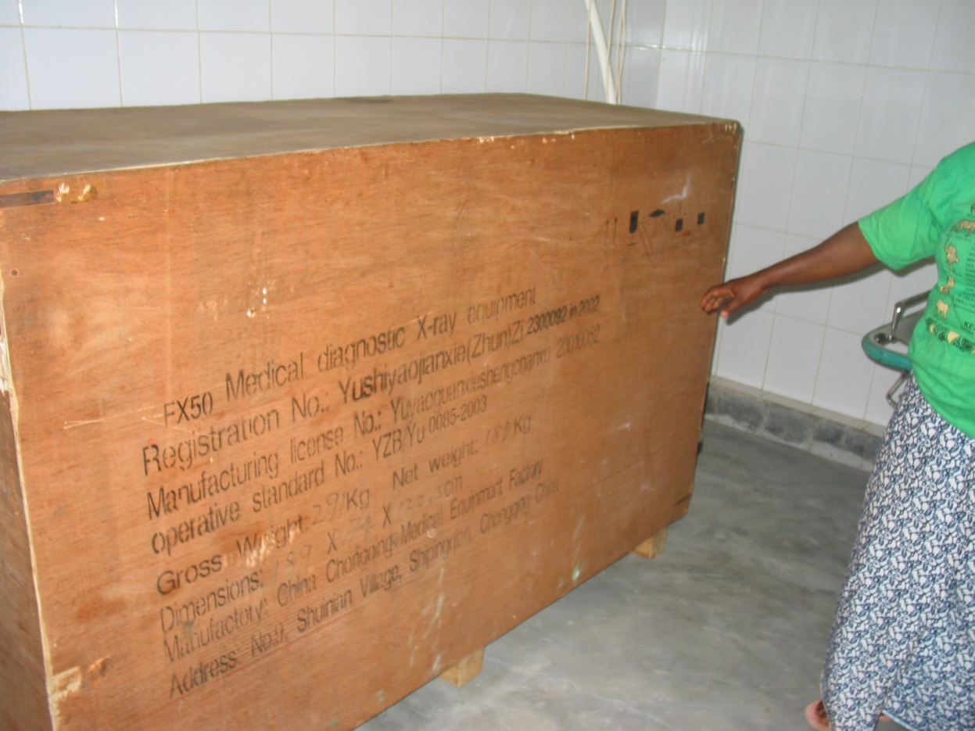
The X-ray machine, which was not able to be used in Ngidinga due to lack of electricity, has been unpacked, installed and is now being put to good use.

Slide 27
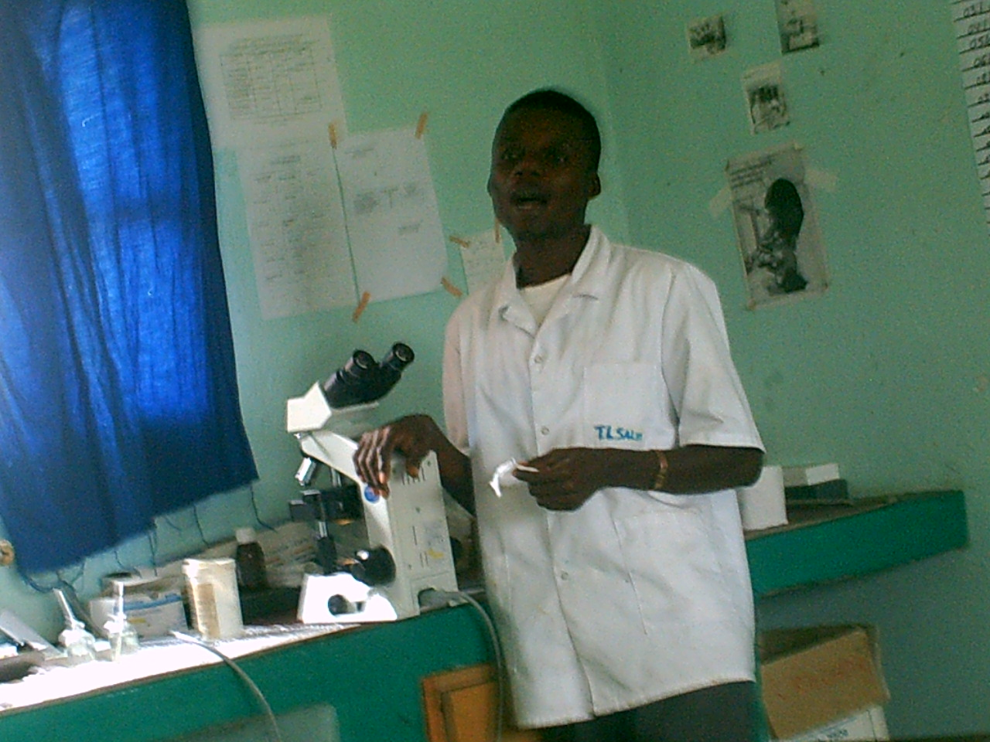
The technician, with purified water available, can work under more sanitary conditions.

Slide 28
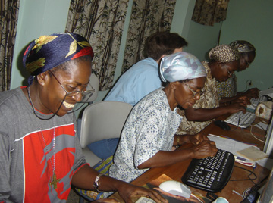
One year later the Sisters from Ngidinga wrote:
“We have been teaching technology skills to the Sisters and other people. We are teaching them to type the text in Microsoft Word, and to use First Class especially the Sisters. Now almost all the Sisters who live in Ngidinga community are able to use the computer and First Class.”

Slide 29
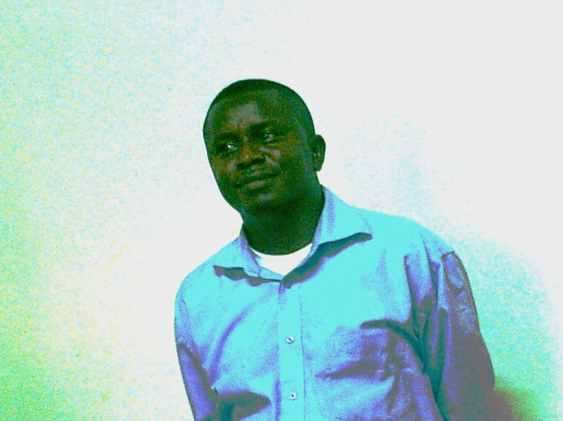
“We have been opening our cybercafé to the population since we got this gift. Some of the people come usually to read the messages in their mail box and some of them still learning how to use the computer even though we do not have enough computers as many people are coming now every day. The kinds of persons who use the computers are: Sisters, Priests, and Students, teachers, doctor and nurses.”
The Doctor,
José Mavuna-Nketo

Slide 30
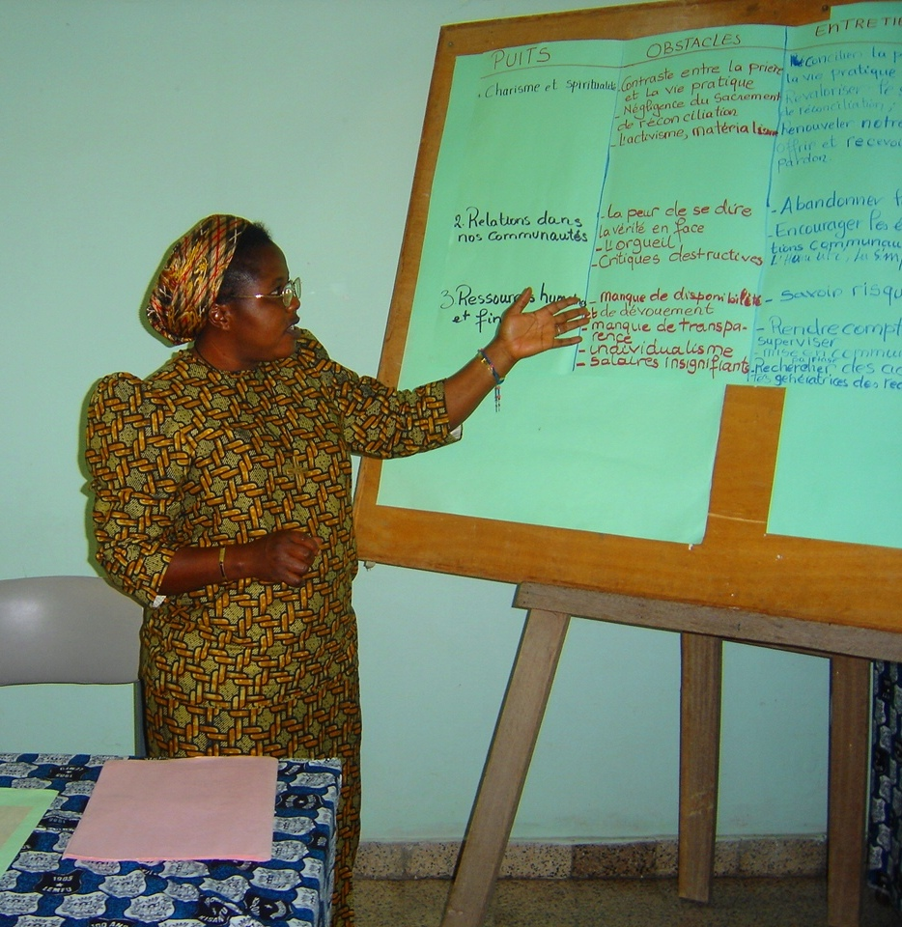
“The cybercafé is helping many people to get to the internet (communications through the world); type their text, and prepare reports .“
“We have already formed 6 persons who are now able to teach other people”
                Sister Dorothée Moya

Slide 31
What is our dream for the future?

Slide 32
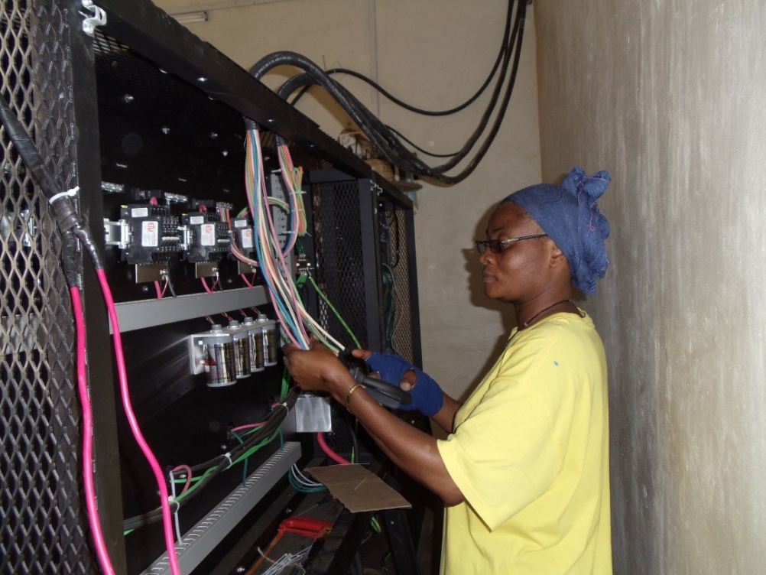
We dream of completing the communication component of the systems in Kitenda, Lemfu and Pelende by October 2010

Slide 33
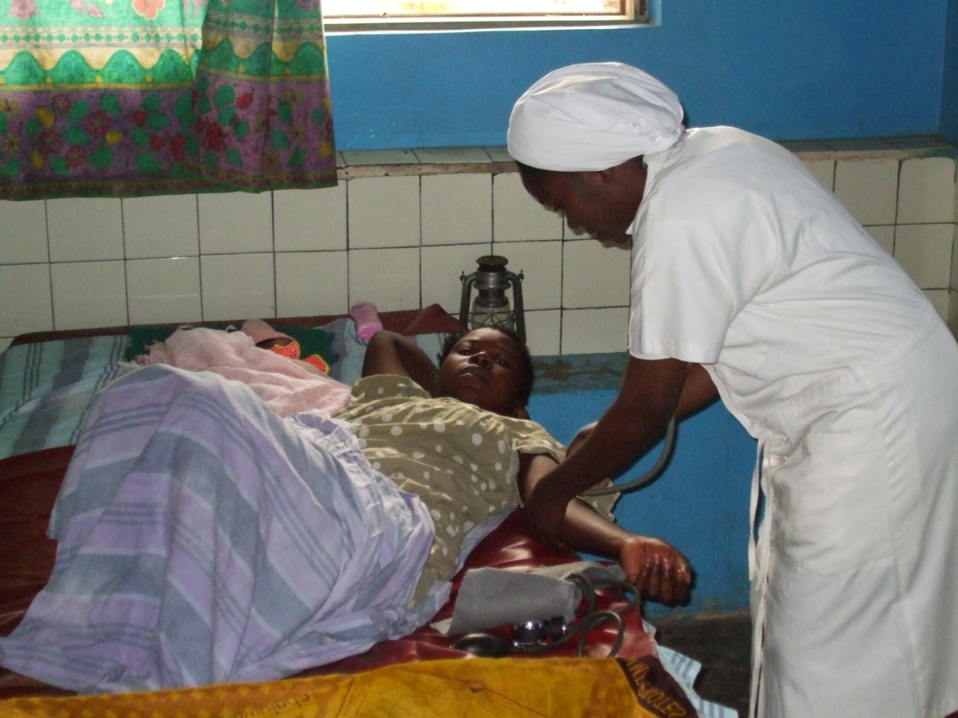
We dream of clean water, electricity and a communication system that will allow doctors and nurses to provide better health care in all the clinics and hospitals run by the Sisters.

Slide 34
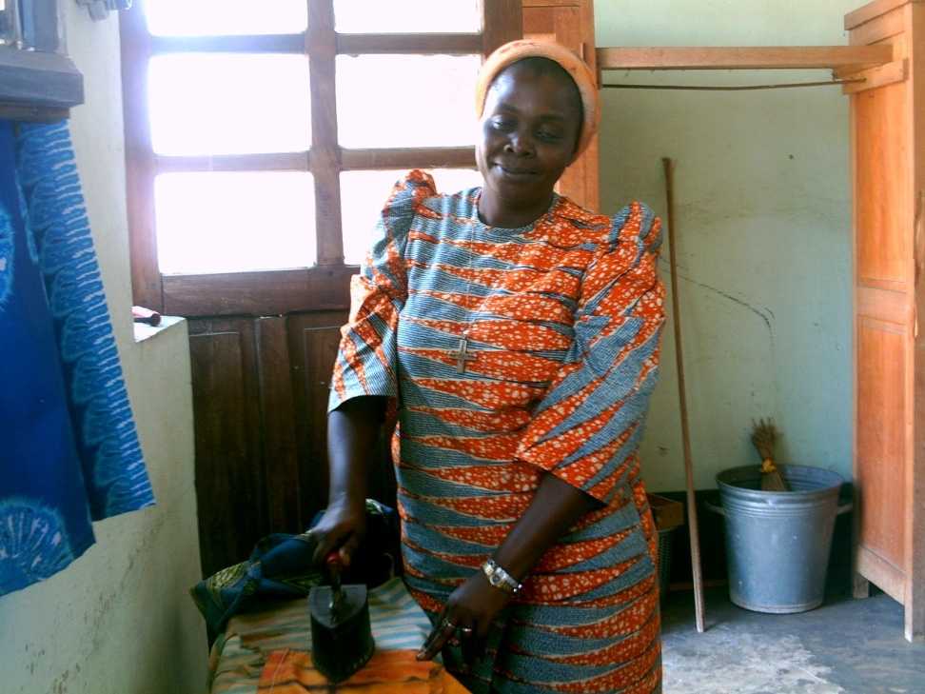
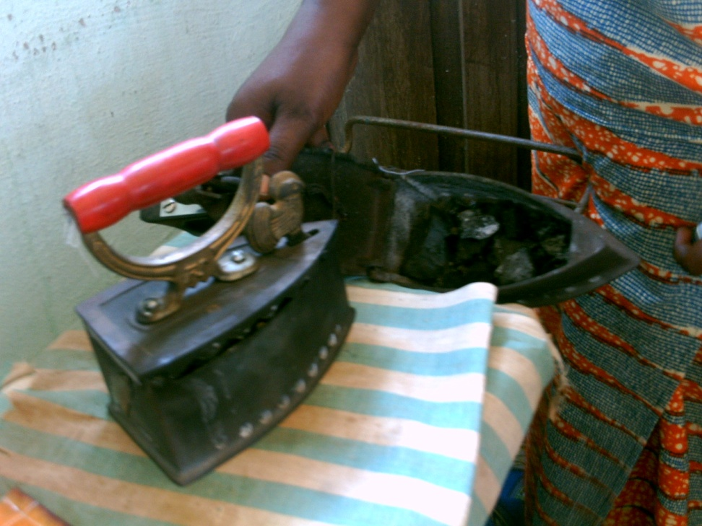
The Sisters dream of having electricity and eliminating the task of ironing with a charcoal iron!

Slide 35
Cost per System:
Panels $68,000
Batteries 12,000
Water Purifier 5,000
Uni Rack 7,200
Charge Controller 6,200
Outback Inverter 10,750
Battery Charger 12,000
Data System 11,000
Grounding 6,000
Shipping 50,000
Customs & Handling 35,000
Labor 45,000
Other 30,000
Total Cost $300,000

Slide 36
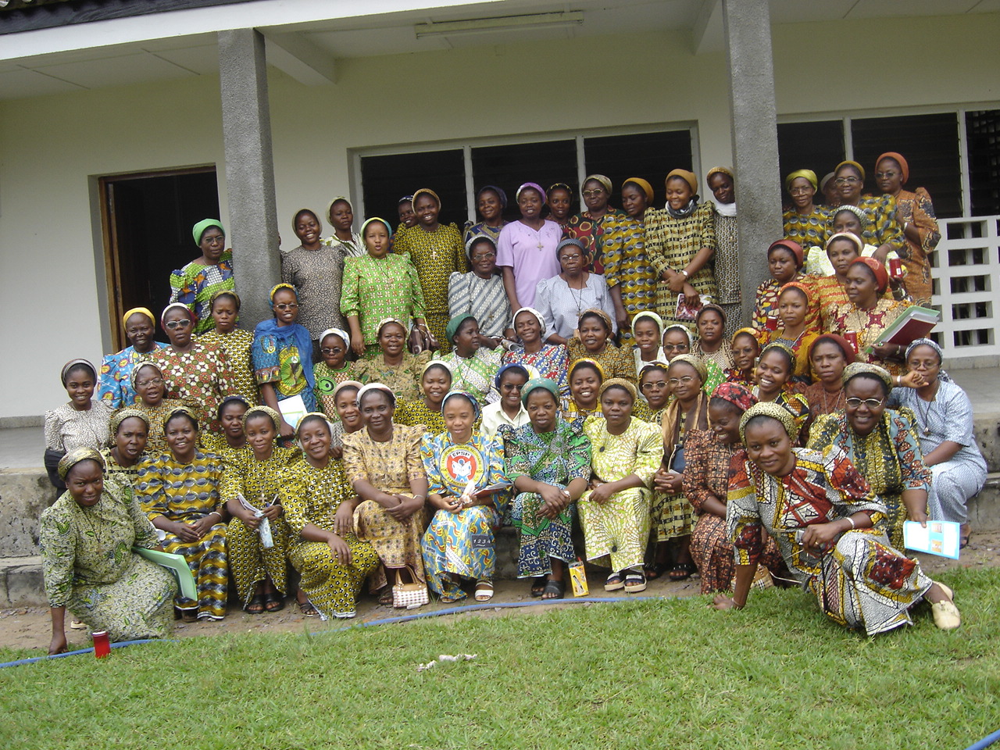
Un gran MERCI! from the Sisters of Notre Dame in Congo-Kinshasa

Slide 37
For more information please contact:
  Sister Lorraine Connell, SND
  Congregational Finance Office
  30 Jeffreys Neck Road
  Ipswich, MA 01938
  987-356-2159 ext. 21
  Lorraine.connell@sndden.org

